Slide 1
Decision tree

Slide 2
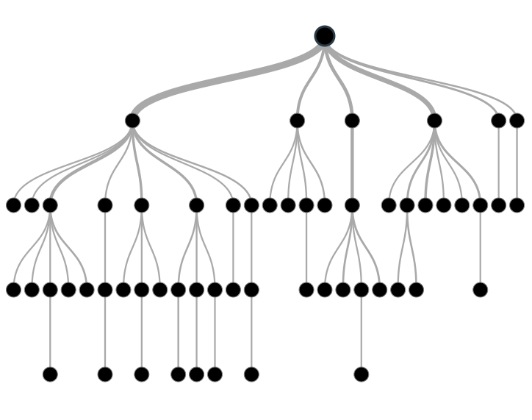
Decision tree
Decision tree is a type of supervised learning algorithm that is mostly used in classification problems.
Decision tress often mimic the human level thinking
so its so simple to understand the data and make
some good interpretations.

Slide 3
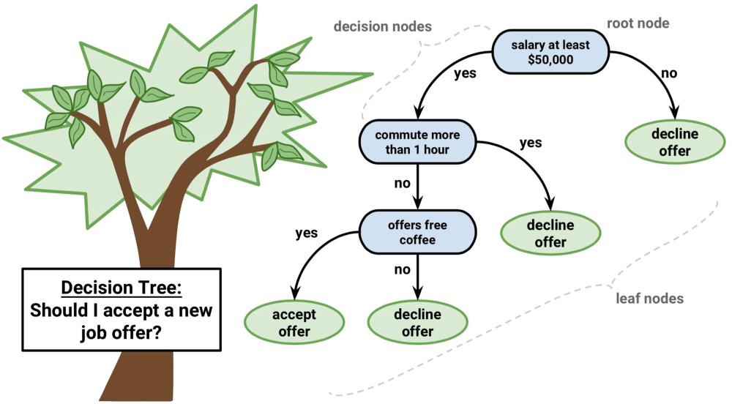
Decision tree
Notes:
https://towardsdatascience.com/a-tour-of-the-top-10-algorithms-for-machine-learning-newbies-dde4edffae11

Slide 4
Decision tree

Slide 5
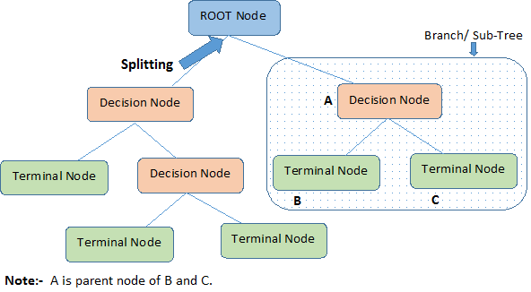
Important Terminology
Root Node: It represents entire population or sample
Splitting: It is a process of dividing a node into two or more sub-nodes.
Decision Node: When a sub-node splits into further sub-nodes, then it is called decision node.
Leaf/ Terminal Node: Nodes do not split is called Leaf or Terminal node.

Slide 6
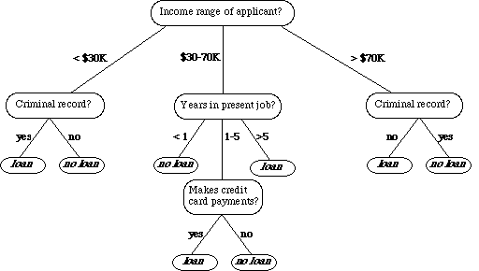
Example: bank loan application

Slide 7
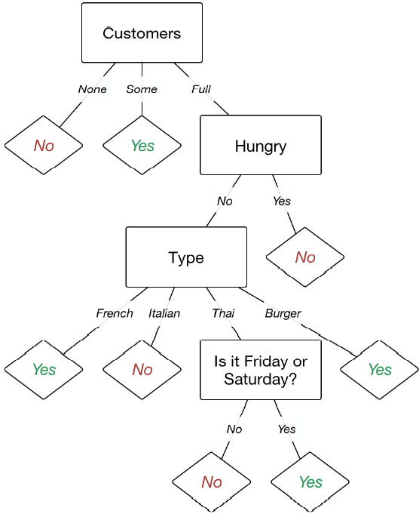
Example: Restaurent

Slide 8
How it works?
Suppose, you like to play tennis.
On a particular day how would you decide whether or not you would play?
Perhaps you would look outside and check to see if it’s cloudy or raining.
Maybe also see how hot (or cold) it is.
Then, you’d use all of this information to inform your decision.
Suppose you recorded the choices you made on different days into a table like the one in next slide:

Slide 9
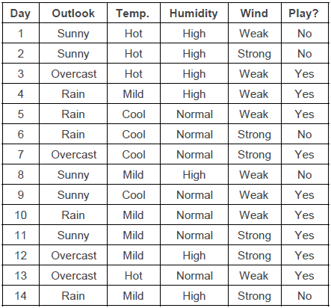
How it works?

Slide 10
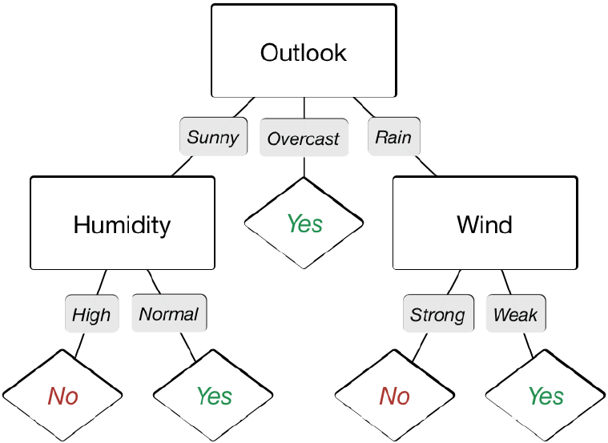
How it works?
With this table, other people would be able to use your intuition to decide whether they should play tennis.
A decision tree would be a great way to represent data like this.
A decision tree for this data allows you to make a decision by following a graph, rather than by looking up your particular situation in a table.

Slide 11
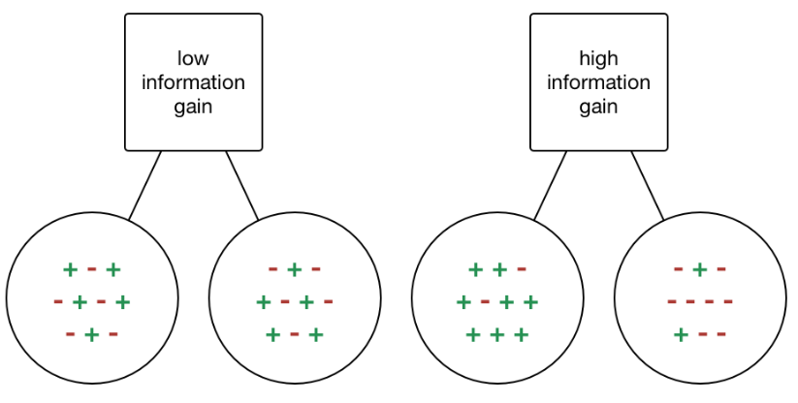
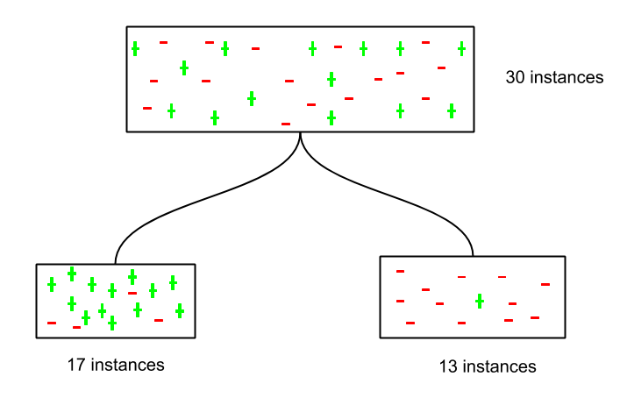
Information Gain
We need to split the data in table using the input variable that gives maximum information gain.

Slide 12
Calculating information gain
Information gain is a statistical property that measures how well a given attribute separates the training examples according to their target classification.
We can see that an attribute with low information gain splits the data such that it doesn’t bring us any closer to a decision.
Whereas, an attribute with high information gain splits the data such that it helps in separating the two from each other.

Slide 13
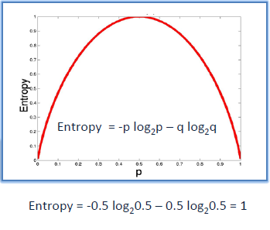
Entropy
Entropy is the measure of homogeneity in the data. Its value is ranges from 0 to 1.

Slide 14
Thanks

